Slide 1

Metholodogy for Creating Custom Wiki base
Aninda Maulik
Mohamadnour Badr
Morad Benkaraache
Dhayananth Dharmalingam

Slide 2
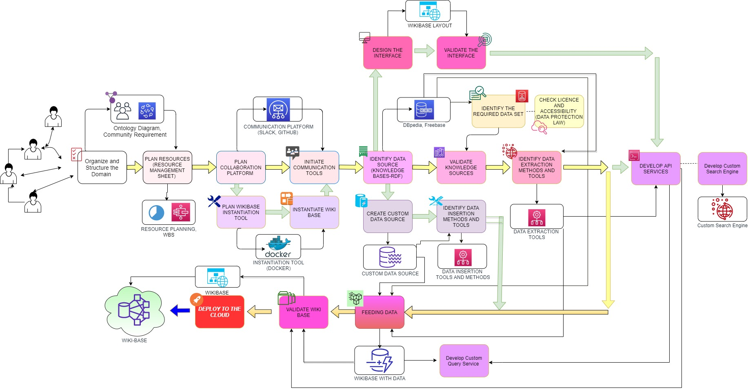
Methodology
T7
T7
T1
T2
T3
T5
T7
T7
T7
T4
T6
T8
T7
T7
T7
T7
T7
T7
T7
T7

Slide 3
Task 1 : Organize and structure the domain
Identify the domain
Research on domain
Consult expert for the gain better understanding and knowledge of the domain (Ex: technical knowledge)
Identify the entitles
Identify the properties
Represent relations between entities and properties

Slide 4
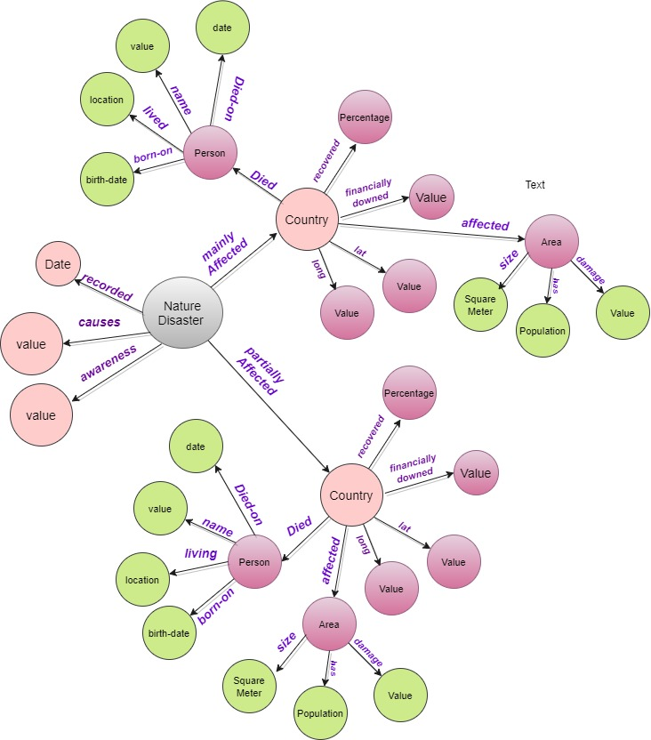
Ontology Diagram

Slide 5
Task 2 : Resource management
Identify the required resource for the project
Define the community organization structure
Flat
Define duties and roles of each member
Estimate the duration
Output- Resource management sheet, WBS
Meeting, discussion point and dates

Slide 6
Task 3 and 4 : Plan Collaboration Platform
Define communication standard
Define sub community – if necessary
Define communication and collaboration tools
Google slides, Google doc, Git-hub, Slack, Skype, Team Viewer
Check the community requirement and flexibility of the selected tool
Initiate collaboration tools

Slide 7
Docker
Wikibase
DigitalOcean
Task 5 : Wiki-base instantiation
Context:
Installing Docker and docker-compose..
Install wikibase .
DigitalOcean.

Slide 8
Docker
Download and Install - Docker.
Download the docker-compose.yml file example(save it into your working directory with the name docker-compose.yml).
Downloading images and starting the containers.
Work as containers
Docker file(5-30 line)
Create images.(run in the container),it will include the node.js ,project code and installment of programs.
By the image name we can run it in any machine.

Slide 9

DigitalOcean
It is a unique cloud hosting provider that offers cloud computing services to business entities so that they can scale themselves by deploying DigitalOcean applications that run parallel across multiple cloud servers without compromising on performance!.
**each client can have his own Droplet, running a chosen Operating system. The client has administrator (root) access to the VPS, so he can make changes without conforming with the other users, which have their Droplets on the same DigitalOcean server.

Slide 10
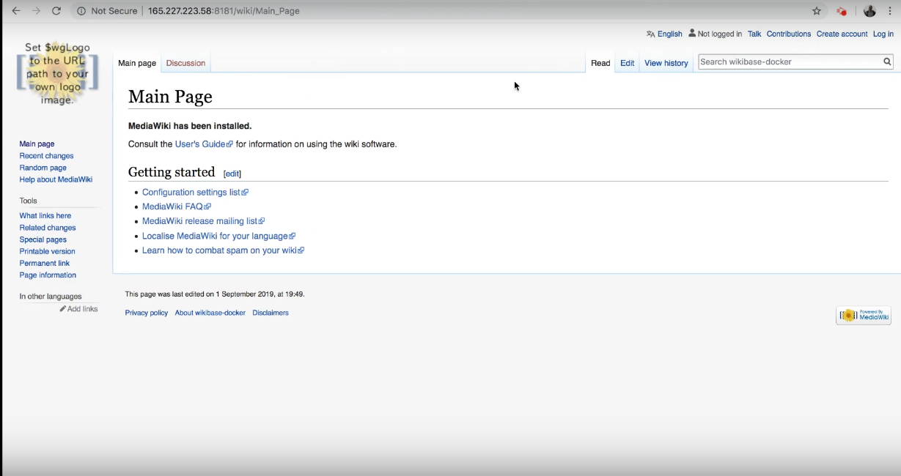
cont.

Slide 11
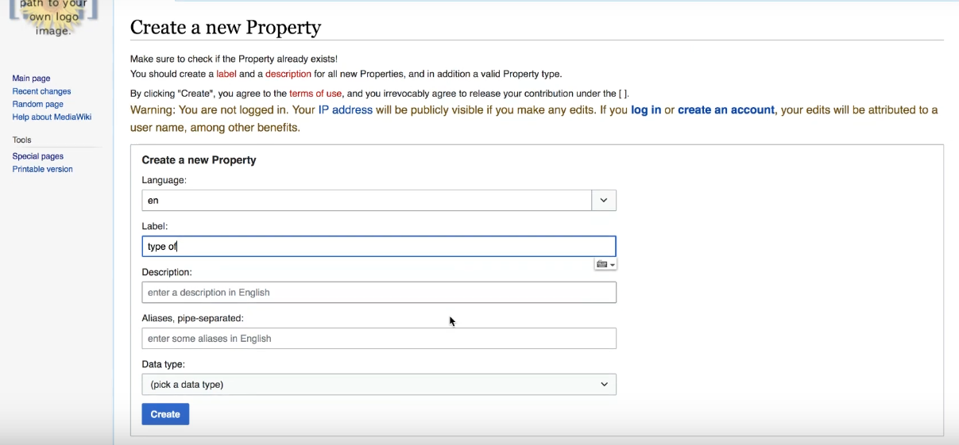
Add data
We can add some data manually from create new property.

Slide 12



Task 6, 7, 8 : Identify the data sources
Identify available data sources (RDF – Data sources)
Wikipedia, Wikidata, WikiMedia, DBPedia (https://wiki.dbpedia.org/), Amazon Neptune
Check data availability
Select Data sources by considering community requirement and domain
Validate the data sources with community members
Identify required data set from those selected data source and check data accessible privilege (Data protection act, Patent rights)

Slide 13



The Data sources
Online Data sources mightnot enough
If we are looking for a very scientific or very specific domain (such as protection data), we can't find everything on Wikipedia.
So we still have to find out about it on other website like (open classroom , universliste, formadoct, google form ...) dedicated to research for the domain, even if sometimes it pays, or we can go further by contacting experts in this field.

Slide 14
Data Insertion and extraction
Wiki base can be a collection of many data sources.
A wiki base community can work together to import data into their wiki base from different bases.
Some of the data sources can be Wikipedia, Wikidata, WikiMedia, DBPedia (https://wiki.dbpedia.org/).
Data extraction requires some sort of pre-requist skills such as experience with wiki page creation and editing, spreadsheet data moving experience and duplicating experience.

Slide 15
Steps for create a new Data
Step 1: Choose data to import
Should choose most reliable data which also required to be accessed publicly. (Preferably online)
Step 2: Start a data import
Community should follow the given link (Wikidata:Dataset Imports) and should create a new import process to initiate the data import process in to wiki data.
Step 3: Import the data into a spreadsheet.
The Wiki data community suggesting to utilize online spread application for this purpose (Ex: GAFAM, Framacalc).

Slide 16
Step 4: Define the structure of the data
Defining the structure of the data is most important part in the process of data import. Structure of the data should be created strictly following the constraints which followed by Wiki data community.
Step 5: Format the data
Original data should be copied within the spreadsheet it self and should be named as “Structure for wiki data”.
The spread sheet must contain the following columns and values
Step 6: Chose how to import the data
Importing process can be automated using Wikidata bot request or can be manually imported using self import method.
Step 7: Match the data to Wiki data
Step 8: Add the data to Wikidata
Step 9: Check and summarise the imported data.

Slide 17
Bot request
Bots can be created to extract data from different data sources to the wiki data.
There are some bot policies and constrains were there. Initially a bot request made to the Wikidata community to test the legitimacy of the bot. and then the tasks of the bot can be accepted or rejected.
The bots can be also created to create a new entity, alter and delete the entity when it identified that it was incorrectly created by bot.
PetScan- for creating items from Wikimedia pages and/or adding same statements to items
QuickStatements- for creating items and/or adding different statements to items
OpenRefine - to import any type of data from tabular sources

Slide 18
Dataset Import
Users can able to import dataset from external sources into wikidata.
The required data for a wikibase can be important using existing data importing tool in wikidata by specifying external link, name and the description of the dataset.
The imported data can be used by other people too.
The documenting and import process page enables platform to the community to collaborate and provides a record for updating, correcting errors and keeping track of updated datasets.

Slide 19
Task 9 : Create Custom Data Source - Optional
Research on custom RDF data bases
Check the features and pricing
Select appropriate data source by considering community requirement and feasibility
SQL Server – Featured with RDF, Amazon Neptune, Apache Marmota, CouchDB, Oracle DB Enterprise Spatial & Graph, GraphQL
Select appropriate data engine and instantiate

Slide 20
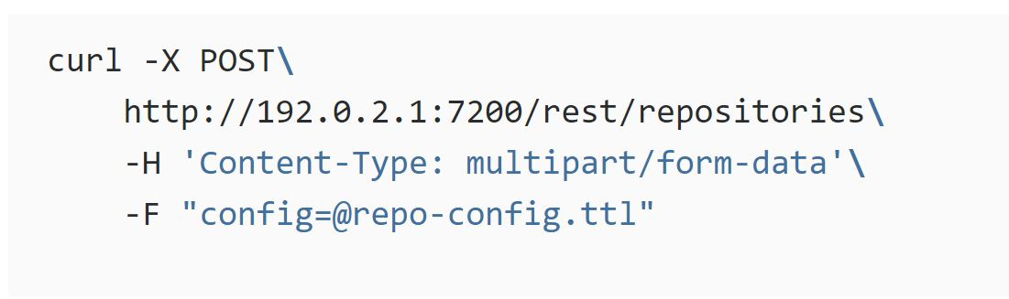
GraphQL
How to Install and initiate Repository
Download your GraphDB .exe file.
Double-click the application file and follow the on-screen installer prompts.
Locate the GraphDB application in the Windows Start menu and start the database. The GraphDB Server and Workbench open at http://localhost:7200/.
Can create a repository or load a repository using configuration of existing repository.

Slide 21
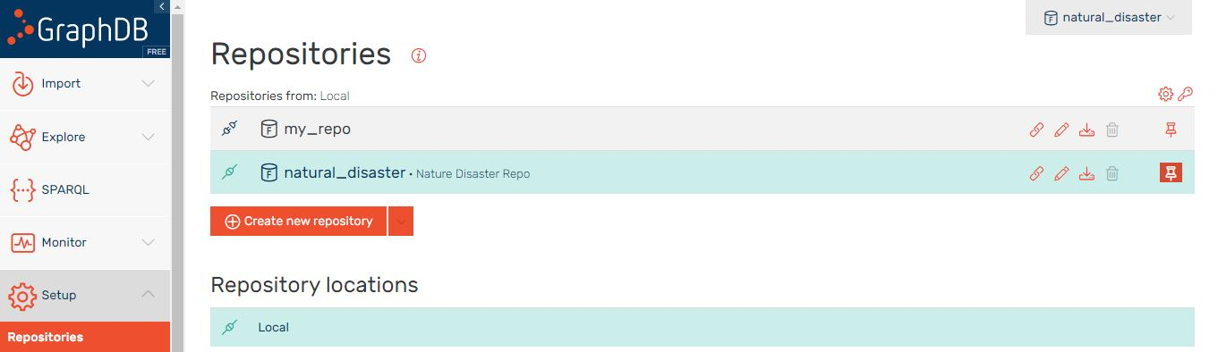
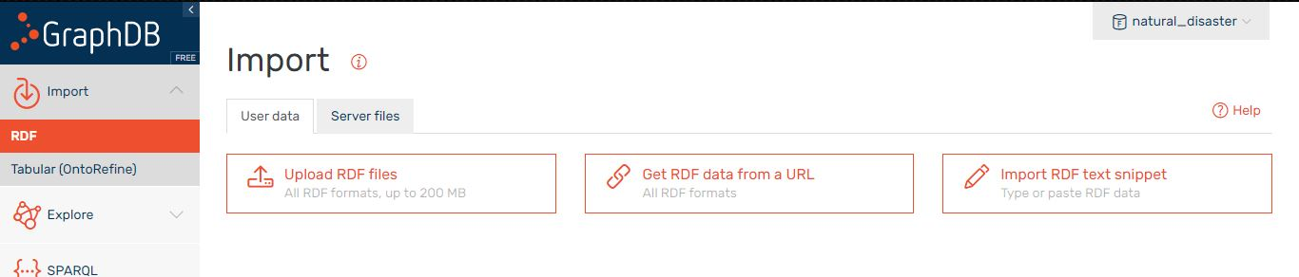
GraphQL

Slide 22
Task 10 : Identify data extraction method and tools
Search data extraction methods and tools for selected RDF Data sources
Validate the tools and technique with other team member
Finalize the method and tools
Direct Query (SpareQL), Exported RDF file, Exported TTL file, API Technique

Slide 23
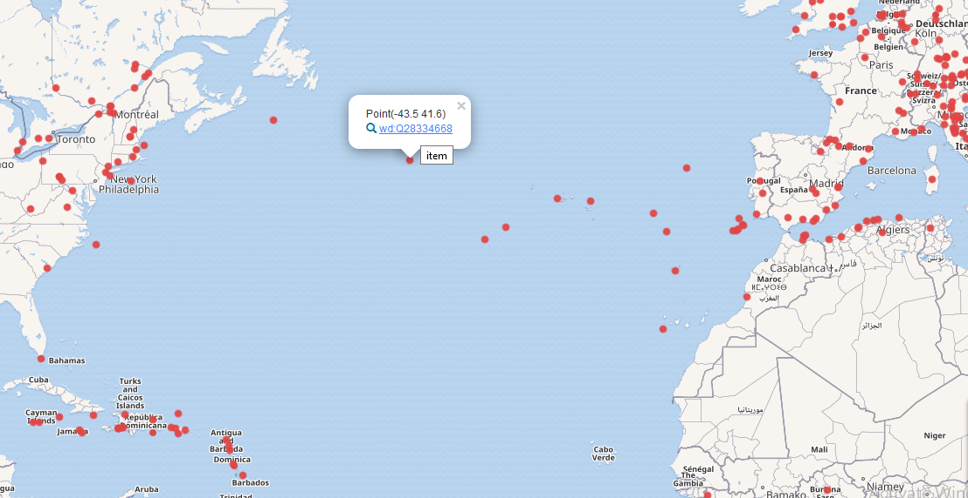
Query Result from (S-Sparql, P-Protocol,A-And,R-RDF,Q-Query,L-Language
#Map of places which got hit my natural disaster
#added 2017-08
#defaultView:Map
SELECT
* WHERE {
?item wdt:P31/wdt:P279* wd:Q8065;
wdt:P625 ?geo .
}

Slide 24
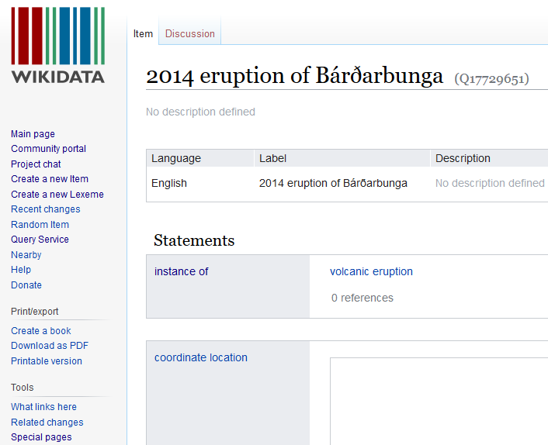
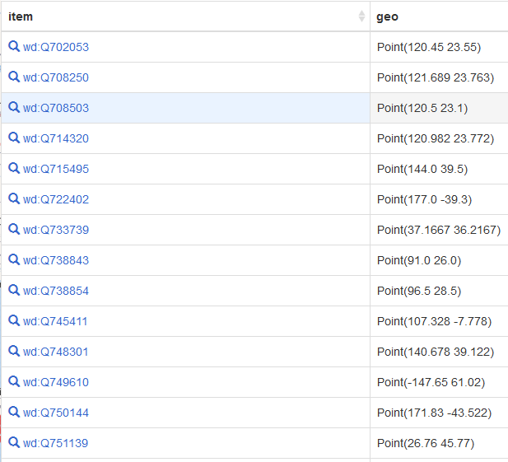
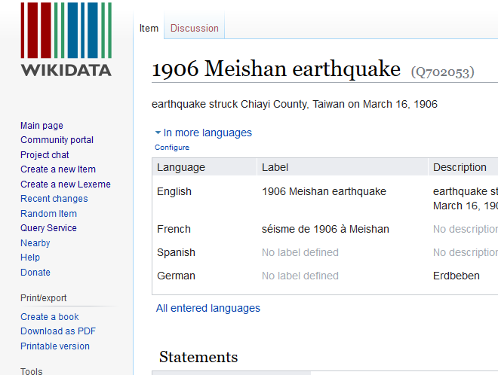
Different result formats
Details gotten from map
The result we get by choosing table option
Choosing the first item from table

Slide 25
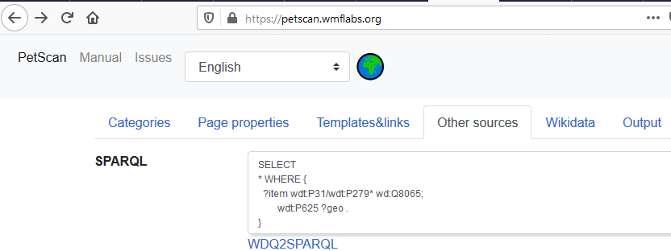
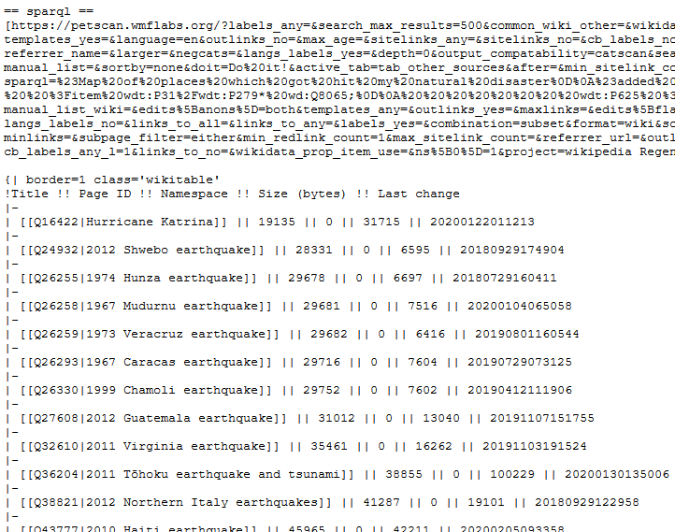
Creating Wikipedia page from query result
Visit wikipedia.org
Create a profile
Edit your profile’s sandbox
Paste that ugly looking text
https://en.wikipedia.org/wiki/User:Bubaimaulik/sandbox
PETSCAN

Slide 26
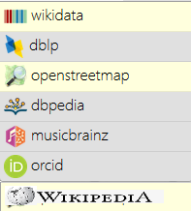
Identifying data sources
My Task
Querying data from the identified data sources
Types of data sources
SparQL
Why identify?
Wikibase
Un-Structured
Structured
Structured
RDF data
Semi-structured
1.Wikidata
2.Wikipedia3.DBpedia
RDF data sources
Triplets
1.Subject
2.Predicate3.Object
Aninda(Subject) is(Predicate) handsome(Object)
Handsome(Subject) is a quality of (Predicate) men(Object)

Slide 27
Sparql techniques to query data from data-sources like wikidata and wikipedia
#wikidata
#Map of places which got hit my natural disaster
#added 2017-08
#defaultView:Map
SELECT
* WHERE {
?item wdt:P31/wdt:P279* wd:Q8065;
wdt:P625 ?geo .
}
#wikipedia
SELECT ?country ?countryLabel ?article WHERE {
?country wdt:P31/wdt:P279* wd:Q8065.
?article schema:about ?country .
?article schema:isPartOf <https://en.wikipedia.org/>.
SERVICE wikibase:label {
bd:serviceParam wikibase:language "en"
}
}

Slide 28
Sparql techniques to query data from data-sources like DBpedia
# dbpedia
PREFIX vrank:<http://purl.org/voc/vrank#>
SELECT DISTINCT ?uni ?uniLabel ?pr WHERE {
?uni wdt:P31/wdt:P279* wd:Q8065.
SERVICE <http://dbpedia.org/sparql> {
?uni vrank:hasRank/vrank:rankValue ?pr
}
SERVICE wikibase:label {
bd:serviceParam wikibase:language "[AUTO_LANGUAGE],en".
}
} ORDER BY DESC(?pr) LIMIT 50

Slide 29
Create Custom Search Engine :Optional
Steps:
Identify querying techniques
Refer to the API document
Check existing application and demos
Hire experts to do the job.
Reuse libraries – Java-Media-Kit

Slide 30
Create Custom Search Engine
Community Activities
Define the requirement
Examine the expected features with community
Decide the architecture with Community
Validate developed application with community members to assure the features

Slide 31
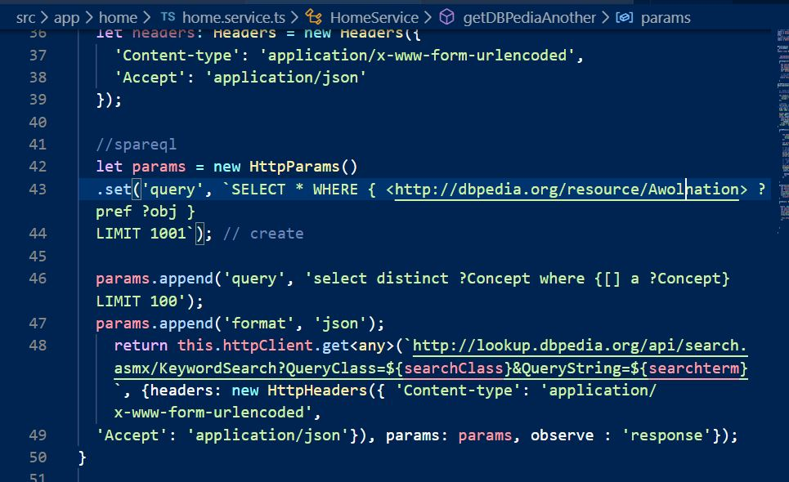
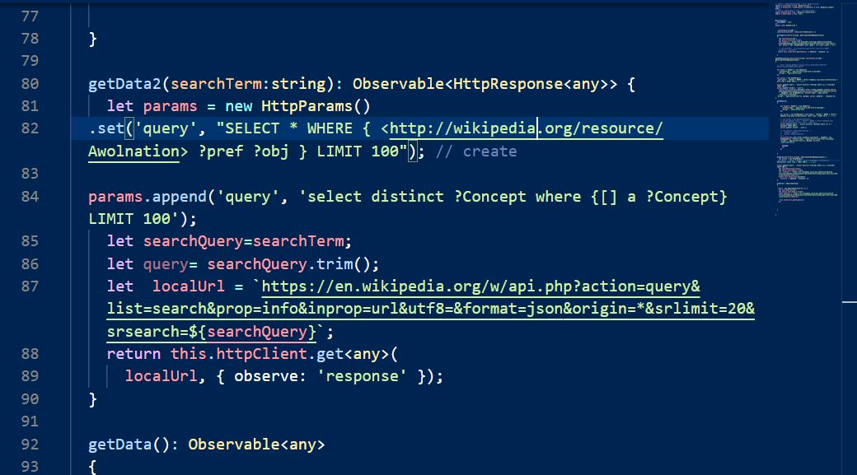
API Query : Spareql
DBPedia API Query
Wiki-data API Query

Slide 32
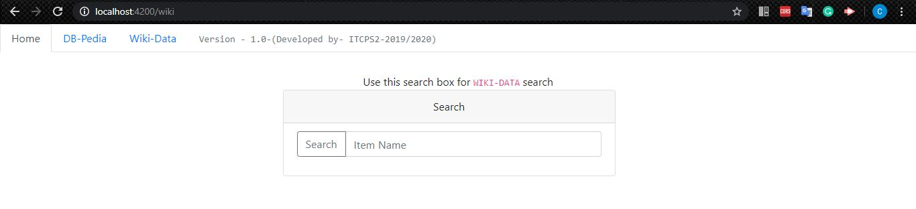
Search Engine

Slide 33
Achievement
Task completed
First Version:
Organize and structure the domain
Resource management
Identifying Collaboration Platform
Identifying Wiki base instantiation method
Identify the data sources Design the interface
Second Version:
Identify data extraction method and tools
Creation of Search Engine
Creation of Wiki-base application
API Programming to extract data to the wiki base

Slide 34
Task to achieve
Inserting new RDF data
Design the interface
Testing the interface
Lunching the custom wiki-base
Documentation

Slide 35
Thank you Questions ?

